Slide 1
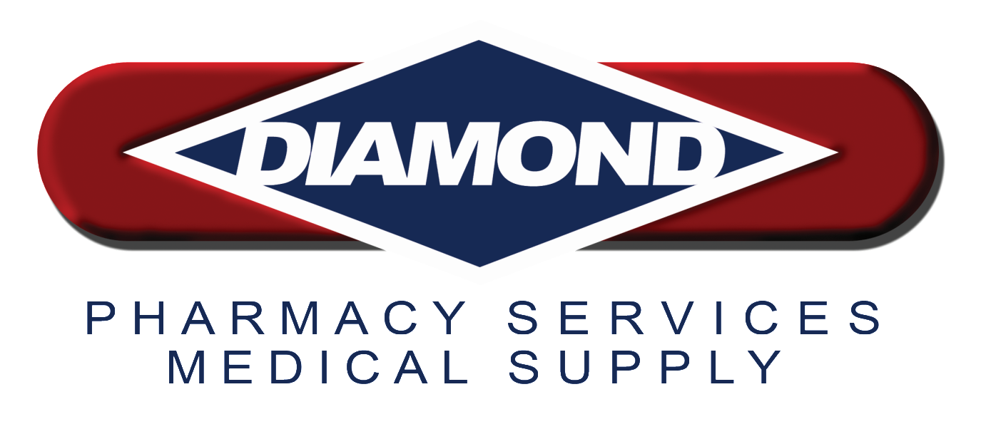
ill
Naloxone
February 7th, 2015
Tom Rafferty

Slide 2
Presentation Outline
Opioids: Defined
Opioid Dependency & Overdose
Emergency Interventions For Overdose
Naloxone
Rescue Kits
Future Of Naloxone
Questions

Slide 3
What are opioids?
An opioid is substance that is derived from the opium poppy, or their synthetic analogues.
Examples:
Heroin
Opium
Oxycontin
Oxycodone
Hydrocodone
Hydromorphone
Fentanyl
Buprenorphine
Levorphanol
Codeine
Lorcet
Lortab
Norco
Oncet
Procet
Vicodin
Xodol
Zydone

Slide 4
Mode of Action
Opioids attach to receptors in brain, spinal cord, intestinal tract and elsewhere and reduce the perception of pain
Addiction
Compulsive drug seeking and use despite negative consequences
Dependence
Occurs due to “normal” adaptations in the body as a result of prolonged exposure to the opioid. Withdrawal symptoms will occur upon discontinuing

Slide 5
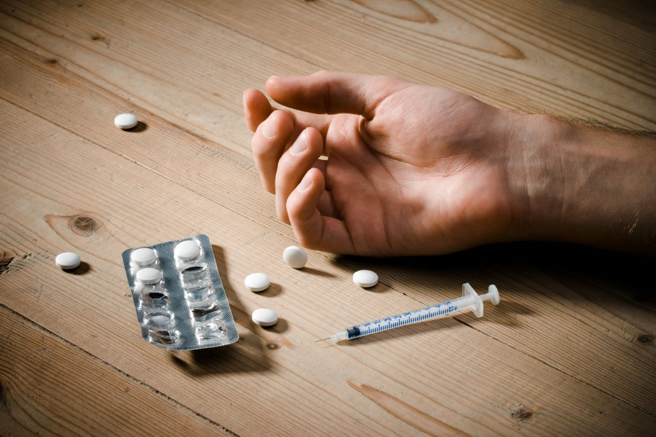
What is opioid dependency?
Body develops a tolerance to opioid substances
User needs higher doses in order to achieve the same effect
User is now at higher risk for overdose

Slide 6
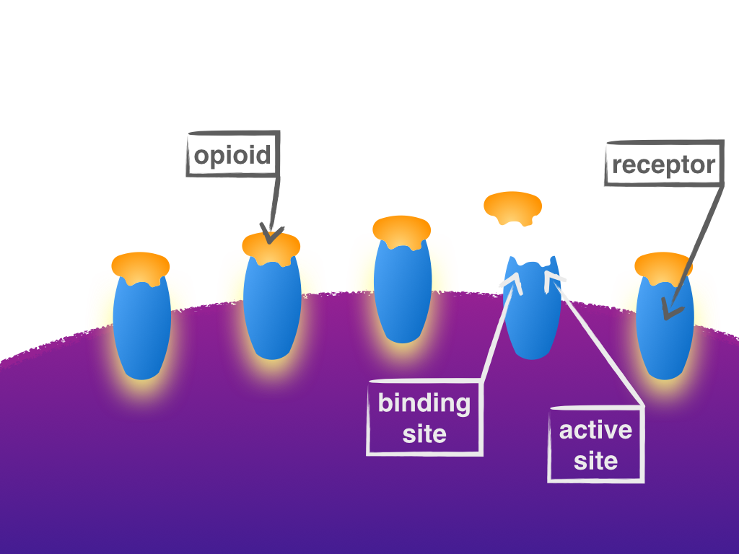
What is an opioid overdose?
Overdose occurs when too much of an opioid substance fits into too many receptors in the brain, slowing and then stopping breathing.

Slide 7
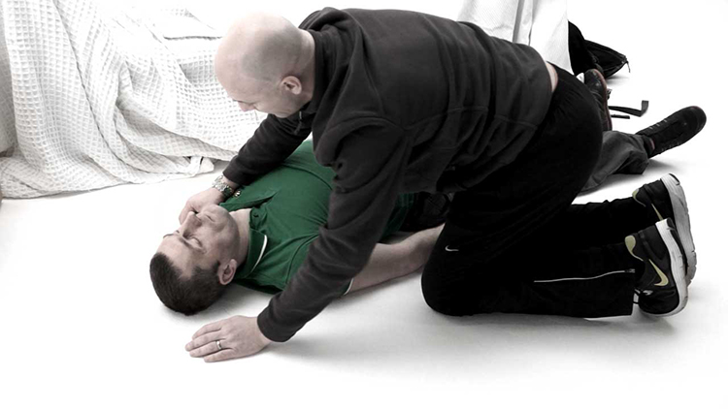
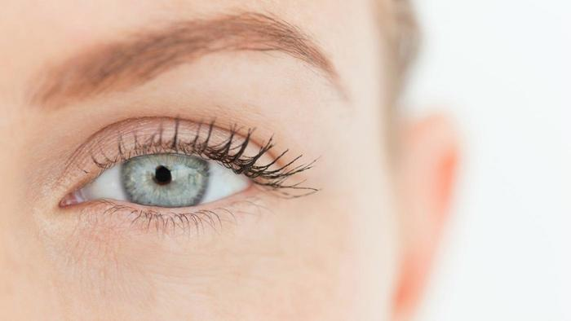
2
Symptoms of an overdose
The three major symptoms known as the “opioid overdose triad”
Pinpoint pupils
Respiratory depression
Unconsciousness

Slide 8
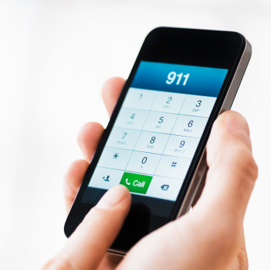
Emergency intervention
Death related to opioid overdose is preventable if the
patient receives early intervention via 911, basic life support, and the administration of naloxone.
Call 911.
Initiate rescue breathing.
Administer naloxone.
Source: National Center for Health Statistics, CDC Wonder

Slide 9

National Overdose Deaths
Number of Deaths from Prescription Drugs
Notes:
National Overdose Deaths—Number of Deaths from Prescription Drugs. The figure above is a bar chart showing the total number of US overdose deaths involving opioid prescription drugs from 2001 to 2013. The chart is overlayed by a line graph showing the number of deaths by females and males. From 2001 to 2013 there was a 2.5-fold increase in the total number of deaths.

Slide 10
National Overdose Deaths
Number of Deaths from Heroin
Notes:
National Overdose Deaths—Number of Deaths from Heroin. The figure above is a bar chart showing the total number of US overdose deaths involving heroin from 2001 to 2013. The chart is overlayed by a line graph showing the number of deaths by females and males. From 2001 to 2013 there was a 5-fold increase in the total number of deaths.

Slide 11
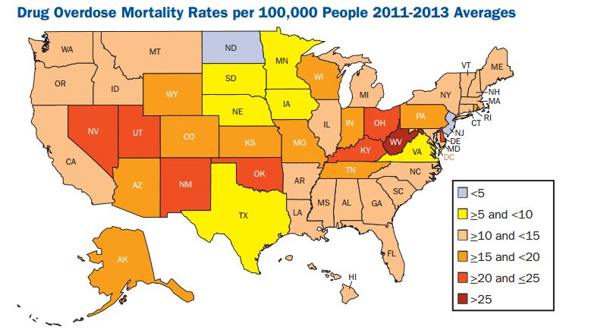

Slide 12
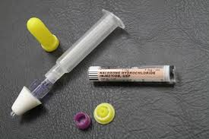
What is naloxone?
Naloxone is an opioid antagonist which blocks or reverses the effects of opioid substances.
Routes of administration:
  Intranasal (IN)
  Intramuscular (IM)
  Subcutaneous (SubQ)
  Intravenous(IV)
Intranasal is the preferred route due to ease, speed, safety, and cost effectiveness.

Slide 13
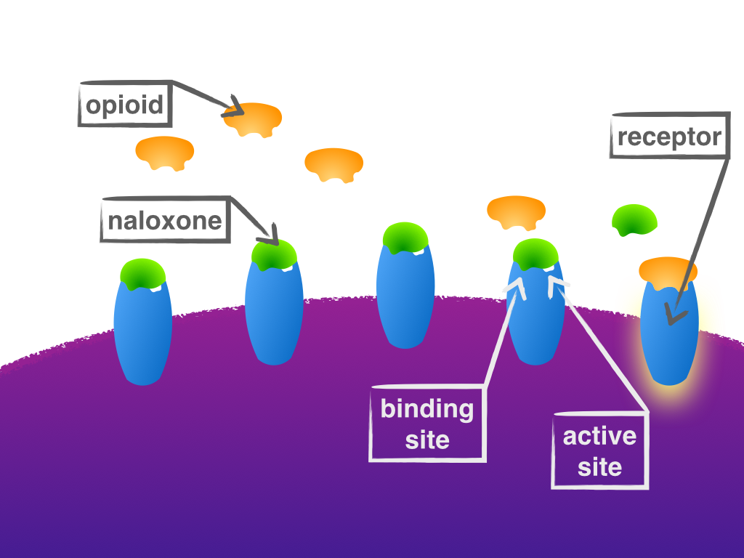
Naloxone reversing an overdose

Slide 14
States carrying naloxone
New Mexico was first state in 2007
As of December 2015, 34 other states have law enforcement who carry naloxone
AK, AR, CA, CO, CT, DE, FL, GA, IL, IN, KY, LA, MA, MD, ME, MI, MN, MS, NC, NH, NJ, NM, NV, NY, OK, OH, PA, RI, TN, VA, VT, WA, WI, WV, and the District of Columbia
Source: www.nchrc.org

Slide 15
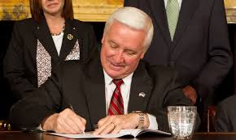
PA Act 139
Sign by Gov. Tom Corbett in 2014
Allows first responders, law enforcement, fire fighters, EMS, and other organizations to administer naloxone
Provides immunity to those responding/reporting overdose

Slide 16
Naloxone kit contents
Carrying case with clasp
Two naloxone syringes
One nasal atomizer
Nitrile gloves
CPR face shield

Slide 17
Just in case?
If a person is unresponsive and it is not known whether Opioids are the cause, can naloxone be administered “just in case”?
Yes. This is standard practice among emergency medical personnel.
Source: Engaging Law Enforcement In Opioid Overdose Response: Frequently Asked Questions, Leo Beletsky, Jd, Mphg.

Slide 18
National Statistics
Since 2014, law enforcement agencies from 34 states have reported 2,600 overdose reversals using naloxone. See some highlights below:
San Diego County Sheriffs – 11 reversals
Monmouth County PDs and Sheriff – >100 reversals
Greenville PD, NC – 4 reversals in 24 hours, March 2014
Quincy PD, MA – 433 reversals
New Jersey – 888 reversals
Source: www.nchrc.org

Slide 19
Future of Naloxone
Eventually all first responders and governmental agencies will be carrying naloxone (similar to how AEDs are now very prevalent)
Education will become more predominant and widespread
Overdose deaths will be lowered and more focus can be placed on treating addicts

Slide 20

ill
Questions

