Slide 1

LEADERSHIP.
COMPASSION.
RESULTS.
What Works To Prevent Overdose Upon Release
Notes:
This presentation explains what works to save lives from overdose in people released from jails.

Slide 2
OVERVIEW
1. BACKGROUND
2. WHAT WORKS FOR COMMUNITY RE-ENTRY
3. NALOXONE
4. PEER SUPPORT PROGRAMS
5. STORIES OF SUCCESS

Slide 3
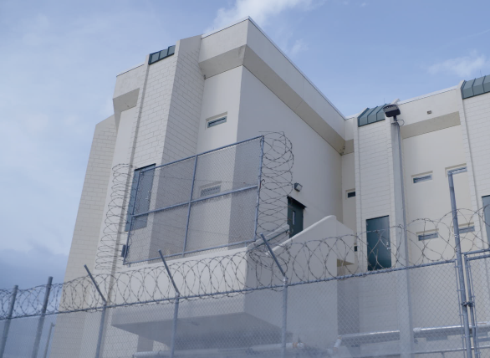
BACKGROUND
Understanding Overdose Risk for People After Release

Slide 4

UNDERSTANDING OPIOID ADDICTION AS A CHRONIC BRAIN DISEASE
Opioid use changes our brain chemistry, making it more likely a person will use
drugs again.
Addiction is a disease, not a character flaw.
Addiction is treatable and recovery is possible.
Notes:
Addiction can happen to anyone at any time. There is no single factor that leads to addiction.
Addiction is a chronic, relapsing brain disease, not a character flaw or moral failing. This is because drug use affects brain function and causes people to use more of a drug to feel the same result and to continue to use drugs regardless of the negative consequences.
However, treatment is available. Just like insulin is needed for diabetes, medications such as buprenorphine, methadone, and naltrexone can treat opioid addiction.
References:
Kosten, T. R., & George, T. P. (2002). The neurobiology of opioid dependence: Implications for treatment. Science & Practice Perspectives, 1(1), 13–20. https://doi.org/10.1151/spp021113
National Institute on Drug Abuse. (2014). Principles of drug addiction treatment: A research-based guide (3rd ed.). National Institutes of Health. https://nida.nih.gov/sites/default/files/soa_2014.pdf

Slide 5


FACTS: OPIOID USE AND INCARCERATION
Nearly 2 out of 3 American adults in custody have a substance use disorder.
About 1 in 4 American
adults in jail have an opioid use disorder.
Notes:
While opioid addiction is a vast and complex issue in society at large, people who struggle with opioid use who are moving through the criminal justice system have a particular set of risks.
Nearly 2 out of 3 American adults in custody have a substance use disorder.
And about 1 in 4 American adults in jail have an opioid use disorder.
References:
Hill, K., Bodurtha, P. J., Winkelman, T. N. A., & Howell, B. A. (2024). Postrelease risk of overdose and all-cause death among persons released from jail or prison: Minnesota, March 2020–December 2021. American Journal of Public Health. https://doi.org/10.2105/AJPH.2024.307723
Substance Abuse and Mental Health Services Administration. (2024). Key substance use and mental health indicators in the United States: Results from the 2023 National Survey on Drug Use and Health (HHS Publication No. PEP24‑07‑021, NSDUH Series H‑59). Center for Behavioral Health Statistics and Quality, SAMHSA. https://library.samhsa.gov/product/2023-nsduh-report/pep24-07-021

Slide 6


FACTS: OVERDOSE RISK UPON RE-ENTRY
1 in 5 people
who die from
a drug overdose
were recently
released from jail.
Adults released from jail have a 10x higher risk of overdose than the general population.
The 2 weeks after release are the
most dangerous for
the risk of overdose.
Notes:
Overdose is the leading cause of preventable death among individuals exiting a correctional setting.
1 in 5 people who die from a drug overdose were recently released from jail.
Adults released from jail have a 10x higher risk of overdose than the general population.
The 2 weeks after release are the most dangerous for the risk of overdose.
Knowing this risk, there are several ways that sheriffs and jail administrators can help reduce the risk of overdose upon re-entry.
References:
Balter, D. R., & Howell, B. A. (2024). Take-home naloxone, release from jail, and opioid overdose—A piece of the puzzle. JAMA Network Open, 7(12), e2448667. https://jamanetwork.com/journals/jamanetworkopen/fullarticle/2827631
Hartung, D. M., McCracken, C. M., Nguyen, T., Kempany, K., & Waddell, E. N. (2023). Fatal and non-fatal opioid overdose risk following release from prison: A retrospective cohort study using linked administrative data. Journal of Substance Use and Addiction Treatment, 147, 208971. https://doi.org/10.1016/j.josat.2023.208971

Slide 7
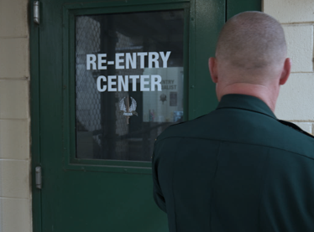
WHAT WORKS
FOR COMMUNITY
RE-ENTRY
Evidence-Based Interventions To Prevent Overdose
Notes:
Naloxone and peer support programs are evidence-based interventions that can help reduce the risk of overdose upon re-entry into the community.
Jails can introduce either one or both of these interventions.
Links to resources to fund and implement these interventions are available on the National Sheriffs’ Association website (which will be shared at the end of this presentation).

Slide 8
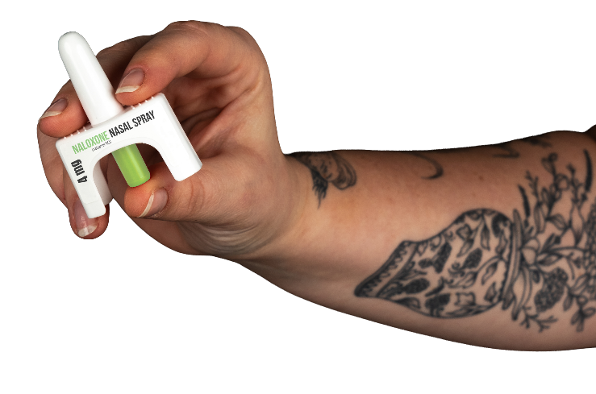
NALOXONE
Notes:
Naloxone is a life-saving medication used to rapidly reverse the effects of an opioid overdose.
It is typically provided in the form of a nasal spray, which is easy for anyone to use.
While education about how to use naloxone is helpful, the medication itself comes with instructions, so no training is required.

Slide 9
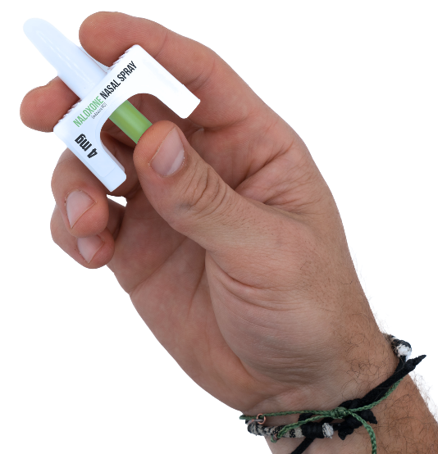
NALOXONE FACTS
It rapidly reverses the effects of an
opioid overdose.
It is safe and does not cause psychoactive effects.
It is endorsed by several federal agencies and is available for purchase with federal funds.
Notes:
Naloxone is a standard medication that is used in emergency medicine for more than 40 years and is the only medication available to reverse the effects of an opioid overdose.
Naloxone does not activate the parts of the brain that produce a “high” nor does it cause an altered mental state. This means that naloxone has no psychoactive effects.
Naloxone is safe and has been endorsed by several federal agencies, including the Centers for Disease Control and Prevention (CDC), the Substance Use and Mental Health Services Administration (SAMHSA), and the National Commission on Correctional Healthcare, as a crucial strategy to prevent overdose deaths.
References:
Centers for Disease Control and Prevention. (n.d.). 5 Things to Know About Naloxone. U.S. Department of Health and Human Services. https://www.cdc.gov/overdose-prevention/reversing-overdose/about-naloxone.html
MedlinePlus. (n.d.). Naloxone injection. U.S. National Library of Medicine. https://medlineplus.gov/druginfo/meds/a612022.html
National Commission on Correctional Health Care. (n.d.). Position Statement: Naloxone in Correctional Facilities for the Prevention of Opioid Overdose Deaths. https://www.ncchc.org/wp-content/uploads/Naloxone-in-Correctional-Facilities-for-the-Prevention-of-Opioid-Overdose-Deaths-1.pdf
National Institute on Drug Abuse. (n.d.). Naloxone drug facts. National Institutes of Health. https://nida.nih.gov/publications/drugfacts/naloxone
Substance Abuse and Mental Health Services Administration. (n.d.). Opioid Overdose Reversal Medications (OORM). U.S. Department of Health and Human Services. https://www.samhsa.gov/substance-use/treatment/overdose-prevention/opioid-overdose-reversal
World Health Organization. (2014). Community management of opioid overdose. https://www.who.int/publications/i/item/9789241548816

Slide 10
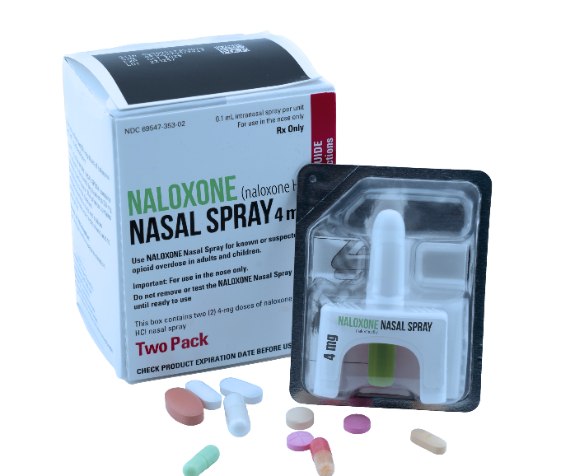
BENEFITS OF NALOXONE DISTRIBUTION
PREVENTS OPIOID OVERDOSE
Distributing naloxone to people released from
jail can prevent up to 25% of overdose deaths.
REDUCES COSTS
Providing naloxone upon release saves about
$11,000 for each prevented death.
IMPROVES COMMUNITY RELATIONS
Offering naloxone shows a commitment to public safety and public health.
Notes:
The benefits of offering naloxone upon re-entry include:
Prevents Opioid Overdose:
Take-home naloxone programs reduce the risk of death by overdose without increasing substance use.
Studies show that distributing naloxone to people released from jail can prevent up to 25% of overdose deaths.
Additionally, naloxone does not prevent people from seeking treatment.
In fact, people who receive naloxone to reverse an overdose are nudged toward treatment because the experience of survival has affected them so strongly.
Reduces Costs:
About $11,000 per person is saved when they are provided naloxone upon release, because it helps them prevent overdose and reduces the need for expensive emergency medical services and hospital care.
Improves Community Relations:
Offering naloxone shows a commitment to public safety and public health and can help build trust and relationships with the community.
References:
Balter, D. R., & Howell, B. A. (2024). Take-home naloxone, release from jail, and opioid overdose—A piece of the puzzle. JAMA Network Open, 7(12), e2448667. https://doi.org/10.1001/jamanetworkopen.2024.48667
National Commission on Correctional Health Care. (2021). Position Statement: Naloxone in Correctional Facilities for the Prevention of Opioid Overdose Deaths. https://ncchc.org/wp-content/uploads/Naloxone-in-Correctional-Facilities-for-the-Prevention-of-Opioid-Overdose-Deaths.pdf
Wenger, L. (2019). A primer for implementation of overdose education and naloxone distribution in jails and prisons. Harm Reduction Coalition. https://harmreduction.org/wp-content/uploads/2020/09/A-primer-for-implementation-of-OEND-in-jails-and-prisons-Wenger-2019-RTI.pdf

Slide 11
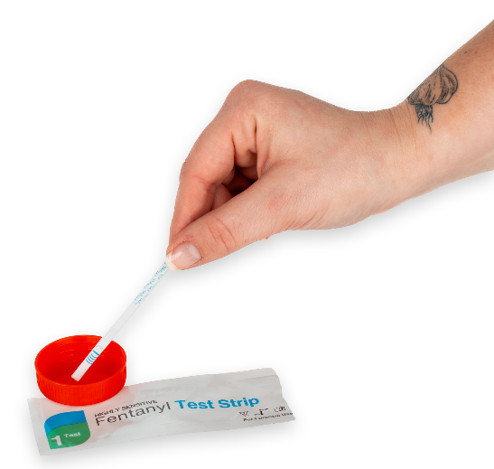
SUPPORTING SAFER RE-ENTRY
Re-entry kits can include naloxone, overdose education, and fentanyl
test strips.
Distributing the kits can engage people in conversations about drug use
and treatment.
Re-entry kits can also include
printed materials with overdose
prevention education.
Notes:
Paired with other re-entry services (such as overdose education and fentanyl test strips), providing naloxone at release can improve outcomes. You can reach out to your state or local health department for printed materials that can be included in re-entry kits.
Studies have shown that distributing re-entry kits through public safety partners (such as local law enforcement) can help engage people in conversations about drug use, risks, prevention, and treatment.
As of the end of 2023, 45 states and the District of Columbia no longer classify fentanyl test strips as drug paraphernalia (does not include Idaho, Indiana, Iowa, North Dakota, and Texas).
References:
Larson, M. J., Silcox, J., Olson, R., Cummins, E., Lopes-McCoy, V., Nong, T., & Green, T. C. (2025). Implementation of a Police-Led Fentanyl Test Strip Distribution Program in Two US States. Substance Use & Misuse, 60(9), 1339–1348. https://doi.org/10.1080/10826084.2025.2497946
Legislative Analysis and Public Policy Association. (n.d.). Fentanyl test strips: State laws. Legislative Analysis and Public Policy Association. https://legislativeanalysis.org/knowledge-lab-state-maps/fentanyl-tests-strips/
Olson, R., Case, P., Palacios, W. R., Hunter, A., Lopes-McCoy, V., & Green, T. C. (2022). Law enforcement and community provision of fentanyl test strips to people who use drugs for engagement and referral to services. Journal of Public Health Management and Practice, 28(Suppl 6), S343–S346. https://doi.org/10.1097/PHH.0000000000001576
Vickers-Smith, R. A., Gelberg, K. H., Childerhose, J. E., et al. (2025). Fentanyl test strip use and overdose risk reduction behaviors among people who use drugs. JAMA Network Open, 8(5), e2510077. https://doi.org/10.1001/jamanetworkopen.2025.10077 (https://jamanetwork.com/journals/jamanetworkopen/fullarticle/2833888)
Wenger, L. D., Showalter, D., Lambdin, B., Leiva, D., Wheeler, E., Davidson, P. J., Coffin, P. O., Binswanger, I. A., & Kral, A. H. (2019). Overdose education and naloxone distribution in the San Francisco County Jail. Journal of Correctional Health Care, 25(4), 343–351. https://doi.org/10.1177/1078345819882771

Slide 12
HOW TO GET NALOXONE
SELF-FUNDING
Direct purchase from manufacturers or retailers
PARTNERSHIPS
State and local health departments
Community-based harm reduction programs
GRANTS
Substance Abuse and Mental Health Services Administration (SAMHSA)
12
Notes:
There are many ways that naloxone can be obtained by jails at a low cost or free of charge, including:
Self-Funding:
Jails can purchase naloxone directly from pharmaceutical manufacturers or retailers who carry naloxone over-the-counter, such as pharmacies or even some grocery stores.
To purchase directly from manufacturers, jails should check their local laws to determine whether a standing order is required. Standing orders may be needed to order types of naloxone that require a prescription or for insurance to cover prescriptions.
There are nationwide systems to order both naloxone and fentanyl test strips at a discount from manufacturers.
Partnerships:
Jails can partner with a variety of organizations to distribute both naloxone and fentanyl test strips.
Look to partner with state and local health departments. Some receive funding from the Overdose Data to Action (OD2A) program to support distributing naloxone and fentanyl test strips to individuals upon re-entry.
Additionally, many community-based programs can provide naloxone and other resources and open up the opportunity for partnerships.
Grants:
There are a variety of federal grants available for jails to supply naloxone and fentanyl test strips, which can be found on SAMHSA’s website. These grants distribute funds to jails or to local governments, to then distribute funds to jails.
References:
California Correctional Health Care Services. (2024, May). Impact of naloxone availability and distribution within the California Department of Corrections and Rehabilitation (CDCR). https://cchcs.ca.gov/wp-content/uploads/sites/60/Impact-of-Naloxone-Availability-and-Distribution.pdf
Network for Public Health Law. (2024, May). Characteristics of statewide naloxone distribution mechanisms. https://www.networkforphl.org/resources/characteristics-of-statewide-naloxone-distribution-mechanisms/

Slide 13
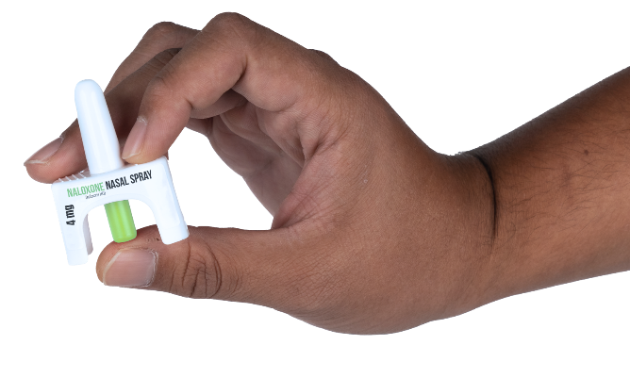
HOW TO DISTRIBUTE NALOXONE
Notes:
There are several ways that jails can go about offering and distributing naloxone and other supplies (such as fentanyl test strips) to people at risk of overdose.

Slide 14
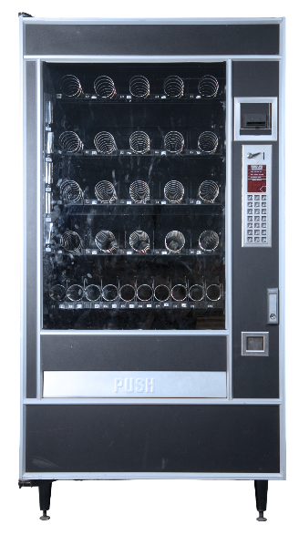
VENDING MACHINES
NALOXONE OFFERED IN VENDING MACHINES
Easily accessible when located within or near a jail.
Conveniently hold several hundred kits in one place.
Minimal staff effort needed for the machine to operate and be restocked.
Easily accessible to people when exiting the jail, including friends and family.
Notes:
Naloxone vending machines can be put in a variety of areas for easy access by those released from jail, including in lobbies, release areas, and other spaces close to the jail.
These convenient locations also make it easy for friends and family to access naloxone.
Vending machines can hold up to 300 naloxone kits, which means that fewer refills are needed.
They can have minimal to no staff burden. Depending on the group with which your jail partners, jail staff may not even be required to restock the machine.
They are highly effective at reducing overdoses for people being released from jail because they make it easy for them to grab naloxone on their way out.
Depending on where the machines are located, returning to get another dose needs little, if any, assistance.
Jails can explore partnerships with public health agencies (such as OD2As) that already operate naloxone vending programs, and/or follow their jurisdiction’s standard procurement or vendor approval processes. Be sure to look for qualified vending machine providers that can support secure medication distribution.
References:
Victor, G., Hedden-Clayton, B., Lenz, D., Attaway, P. R., & Ray, B. Naloxone vending machines in county jail. J Subst Use Addict Treat. 2024;167:209521. https://doi.org/10.1016/j.josat.2024.209521
Wayne State University Center for Behavioral Health and Justice. (2021). Expanding Naloxone Distribution in County Jails. https://behaviorhealthjustice.wayne.edu/naloxone_toolkit/cbhj_naloxone_toolkit_june-2021.pdf
Companion Materials:
Augusta Chronicle. This Georgia sheriff’s office launches free Narcan vending machine. Here’s how it works. https://www.augustachronicle.com/story/news/2025/06/09/this-georgia-sheriffs-office-installs-narcan-vending-machine/84115879007/

Slide 15
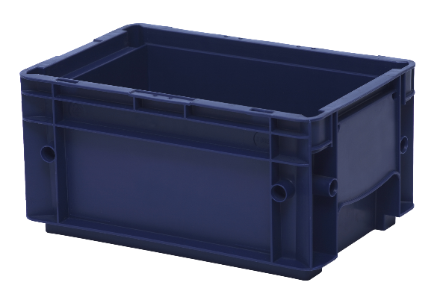
PROPERTY BOXES
NALOXONE PLACED IN PROPERTY BOXES AT RE-ENTRY
Requires low-to-medium effort for jail staff to implement, depending on the logistics.
Ensures that people have naloxone with them when they are released.
Notes:
Placing naloxone in property boxes upon release is a discreet way to provide naloxone.
Kits can be placed in all property boxes for people exiting jail or given to specific people.
Placing naloxone in ALL personal property boxes can lower the burden on staff.
Keep in mind that:
Placement in property boxes is often just before release due to the expiration dates on naloxone. However, releases can be unexpected.
Jails may restrict who can actually place naloxone in property boxes.
This is most effective when naloxone is placed in ALL property boxes, and people being released can “opt out” by returning it on their way out of the jail. If naloxone is placed in the property boxes of specific people, the impact will be moderate because not everyone will have it.
Reference:
Wayne State University Center for Behavioral Health and Justice. (2021). Expanding Naloxone Distribution in County Jails. https://behaviorhealthjustice.wayne.edu/naloxone_toolkit/cbhj_naloxone_toolkit_june-2021.pdf

Slide 16
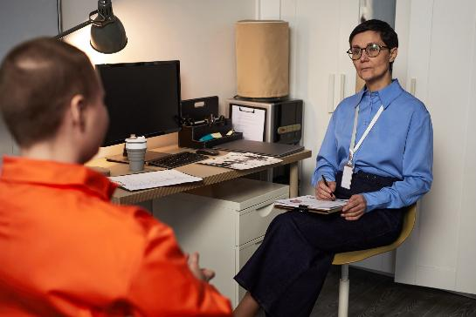
REFERRALS
REFER PEOPLE TO LOCAL ORGANIZATIONS THAT PROVIDE NALOXONE
Lag time between referrals and having naloxone in hand is reduced.
Low-to-medium effort for jail staff depending on the referral type.
Naloxone is not directly provided.
Notes:
Jail staff can also refer individuals being released to community organizations, such as health departments and community-based agencies, to receive naloxone.
These organizations tend to keep more naloxone kits on hand than many jails.
With this method, jail staff inform people which organizations can provide them with naloxone. Most organizations also offer instructions on how to use naloxone.
The burden on jail staff ranges from low to medium, depending on how involved the referrals are. For example, will they be warm handoffs or will staff be handing over contact information?
This option is considered slightly effective at reducing overdose for the people being released because it is an indirect method of providing naloxone.
Reference:
Wayne State University Center for Behavioral Health and Justice. (2021). Expanding Naloxone Distribution in County Jails. https://behaviorhealthjustice.wayne.edu/naloxone_toolkit/cbhj_naloxone_toolkit_june-2021.pdf

Slide 17
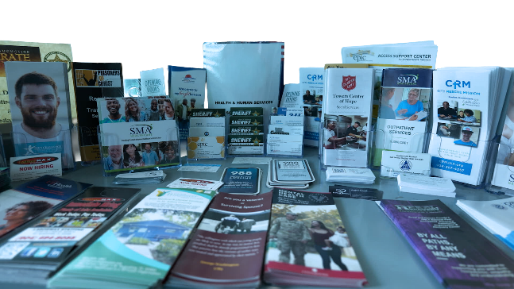
SIGNS AND BROCHURES
INFORMATIONAL MATERIALS POSTED OR SET OUT FOR DISTRIBUTION IN
THE RE-ENTRY AREA
Shares information widely.
Can be provided by state and local health departments.
Requires little maintenance to hang posters and replenish materials.
Places the burden on the person to find naloxone for themselves.
Notes:
Informational signs and materials, such as brochures and business cards, can widely share information about how to get naloxone upon release.
Reach out to your state and local health department to obtain materials.
Materials should be in a high-traffic area, such as a release room or the lobby of a jail, where they can be seen, read, and easily taken.
Staff only need to hang posters and replenish brochures or other take-away items, which can be done either on a schedule or an as-needed basis, lowering the burden on them.
This approach is considered slightly effective because no naloxone is given to people—they need to go out and get it.
Reference:
Wayne State University Center for Behavioral Health and Justice. (2021). Expanding Naloxone Distribution in County Jails. https://behaviorhealthjustice.wayne.edu/naloxone_toolkit/cbhj_naloxone_toolkit_june-2021.pdf

Slide 18

PEER SUPPORT PROGRAMS
Notes:
Peer support programs connect individuals with shared experiences to provide mutual support, guidance, and understanding.
While some jails may be able to hire their own in-house peer support specialists, many jails can work with existing peer-run programs to offer services to people in and exiting jail.

Slide 19
PEER SUPPORT SPECIALISTS:
A BRIDGE TO RECOVERY
WHO ARE THEY?
People with lived (direct, personal) experience with opioid use and sometimes incarceration.
Individuals trained to work with others and in de-escalation techniques.
WHAT DO THEY DO?
Help with reintegration into the community.
Help people stick to individual treatment and recovery goals.
Link people to services.
Support transportation to appointments.
Lead naloxone trainings.
Notes:
Peer support specialists are people who have lived experience with opioid use and sometimes incarceration who can uniquely connect with people who are incarcerated.
They are trained to work with others who are dealing with opioid use and/or who are incarcerated, with additional training in boundaries, de-escalation techniques, and ethics.
Studies have shown that jails with peer support programs often experience fewer behavioral incidents and improved safety thanks to the rapport and trust that peers build. ​
Peer support specialists who work in jails can:
Help people reintegrate into their community.
Help people successfully stick to their treatment and recovery goals.
Link people to a variety of services upon release, including job placement and training programs.
Provide transportation to and accompaniment during appointments.
Lead naloxone trainings.
References:
Adams, W. E., & Lincoln, A. K. (2021). Barriers to and facilitators of implementing peer support services for criminal justice-involved individuals. Psychiatric Services, 72(6), 626–632. https://doi.org/10.1176/appi.ps.201900627​
Choi, Y. H., Burden, E., Cloyd, S., & Hayes, E. (2024). Integrating peer programs for people who use drugs [PDF]. National Council for Mental Wellbeing. https://staging.thenationalcouncil.org/wp-content/uploads/2024/03/Integrating-Peer-Programs-for-People-Who-Use-Drugs.pdf
Harris, R. A., Campbell, K., Calderbank, T., Dooley, P., Aspero, H., Maginnis, J., et al. (2023). Integrating peer support services into primary care-based OUD treatment: Lessons from the Penn integrated model. Substance Abuse. Advance online publication. https://pmc.ncbi.nlm.nih.gov/articles/PMC9933784/
Hamilton, Jonah BSc; Ti, Lianping PhD; Korchinski, Mo RSW; Nolan, Seonaid MD. Peer Support Specialists: An Underutilized Resource in the Criminal Justice System for Opioid Use Disorder Management?. Journal of Addiction Medicine 16(2):p 132-134, March/April 2022. https://journals.lww.com/journaladdictionmedicine/abstract/2022/04000/peer_support_specialists__an_underutilized.4.aspx.

Slide 20
BENEFITS OF PEER SUPPORT SPECIALISTS:
A BRIDGE TO RECOVERY
LOWERS RECIDIVISM
Reduces jail bookings and improves re-entry outcomes.
CUTS COSTS
Reduces the cost of re-incarceration and court proceedings.
CONNECTS PEOPLE TO TREATMENT
Increases the likelihood that people enroll and stay in treatment.
20
Notes:
Offering peer support programs helps to:
Reduce recidivism:
Peer involvement has led to measurable reductions in jail bookings in some jurisdictions.
Peer support programs have also been shown to have higher participation and improved re-entry outcomes.
Reduce costs:
Peer support programs contribute to lower rates of reoffending, directly reducing the costs of re-incarceration, court proceedings, and supervision.
Increase linkages to treatment:
Peer support specialists act as trusted guides, motivators, and connectors and increase the likelihood that people enroll and stay in substance use disorder treatment.
They help people manage substance use challenges, prepare for re-entry, and build resilience.
References:
Hyde, J., Byrne, T., Petrakis, B. A., Yakovchenko, V., Kim, B., Fincke, G., et al. (2022). Enhancing community integration after incarceration: Findings from a prospective study of an intensive peer support intervention for veterans with an historical comparison group. Health & Justice, 10(1), 33. https://doi.org/10.1186/s40352-022-00195-5
Treitler, P., DiGioia‑Laird, V., & Long, B. (2025). Peer support services for individuals with health‑related needs reentering the community after incarceration: A scoping review of program elements and outcomes. Health & Justice, 13, Article 51. https://doi.org/10.1186/s40352-025-00358-0

Slide 21
HOW TO PROVIDE PEER
SUPPORT SERVICES
PARTNERSHIPS
Community-based programs
State and local health departments
GRANTS
Federal, state, and local
SELF-FUNDING
Train existing staff
Recruit volunteers
Train people who are currently incarcerated
Notes:
Peer support can take many forms, whether through in-house staff or partnering with programs. Ways to implement peer support services include:
Partnerships
Recovery Community Organizations provide peer-based recovery support services and may also deliver public education.
State and local health departments can help implement peer support programs in jails without the jail needing to operate the program themselves.
Grants and Funding
Federal grants are available through the Substance Abuse and Mental Health Services Administration (SAMHSA) to fund peer support services.
Funding from state and local health departments through CDC’s OD2A program is used to fund peer support services as part of its broader strategy to reduce overdose deaths and improve access to care.
Self-Funding
If jails want to self-fund their peer support services, they can:
Train existing jail staff or volunteers with lived experience.
Recruit people who were formerly incarcerated, or students in social work or criminal justice, to serve as peer mentors.
Train people who are currently incarcerated to serve as peers, giving them a pathway to work in the community upon release.
References:
University of Texas at Austin. (2019). Recovery community organizations: An exploration of organizational function and capacity. https://www.tiemh.org/wp-content/uploads/2021/12/2019-Recovery-Community-Organizations-An-Exploration-of-Organizational-Function-and-Capacity_REPORTS.pdf

Slide 22
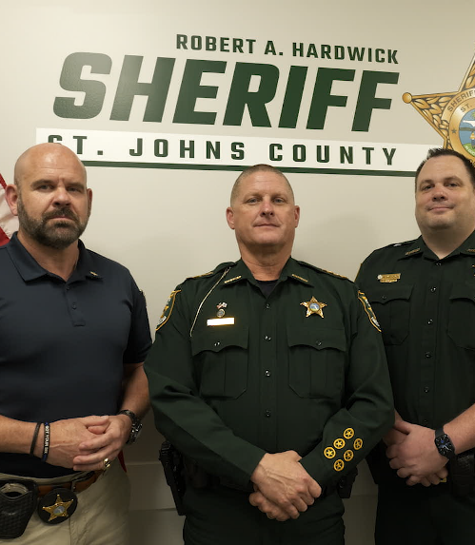
STORIES
OF SUCCESS
Jail Programs That Are Making a Difference
22

Slide 23

PARTNERSHIPS THAT SAVE LIVES
KNOXVILLE DETENTION FACILITY
Jail staff conduct medical screenings during intake.
Jail staff refer at-risk people to health department peer navigators.
Peer navigators ensure that people receive overdose education and naloxone.
IN 1 YEAR:
Provided 185 contact hours to 326 people.
Provided naloxone to 197 people.
Distributed 796 total naloxone doses.
Notes:
At the Roger D. Wilson Detention Facility in Knoxville, Tennessee, jail staff conduct medical screenings of individuals as part of the intake process and refer those who are at risk for substance use disorders to Knox County Health Department peer navigators.
The peer navigators ensure that these individuals receive overdose education and naloxone upon release, which is crucial for reducing their overdose risk during re-entry into the community.
In 1 year, from February 2024 to January 2025,
Health department navigators dedicated 185 contact hours to providing overdose education to 326 unique clients.
Of these 326 clients, 197 received naloxone upon release, totaling 796 doses distributed.
The Knox County Health Department collaborated closely with the jail’s health administrator to foster a culture of risk reduction and improve communication between medical staff and the health department.
Source: Provided by Centers for Disease Control and Prevention (CDC) Overdose Data to Action (OD2A) program

Slide 24
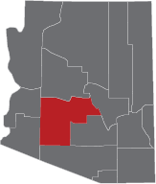
IMPROVING ACCESS TO CARE
MARICOPA COUNTY CORRECTIONAL HEALTH SERVICES
Hired 2 peer navigators and 1 community transition manager.
IN 1 YEAR:
Made 1,518 referrals for medications for opioid use disorder (MOUD).
Helped 2,043 people.
Provided naloxone kits and overdose education to
8,211 people.
Enrolled 18 people in outpatient services.
Referred 6 people to inpatient treatment.
Notes:
Maricopa County Correctional Health Services in Arizona hired two navigators and one community transition manager to improve access to critical care and help prevent overdose among individuals at high risk.
In the jail setting, from February 2024 to January 2025, the navigator team:
Made 1,518 referrals to medications for opioid use disorder (MOUD).
Provided 2,525 navigation hours to 2,043 justice-involved individuals.
Provided naloxone kits and overdose prevention education to 8,211 individuals upon release.
Enrolled 18 individuals in outpatient behavioral health services, including substance use disorder treatment.
Made 6 inpatient treatment referrals.
Source: Provided by Centers for Disease Control and Prevention (CDC) Overdose Data to Action (OD2A) program

Slide 25
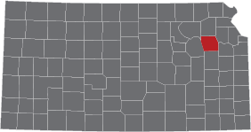
PEER SUPPORT THAT IS PERSONALIZED
SHAWNEE COUNTY DETENTION CENTER
Hired 1 full-time peer navigator.
IN 90 DAYS:
Completed 159 service requests.
Held 147 one-on-one meetings.
Distributed 67 naloxone and fentanyl test strip kits.
Made 18 referrals to community-based recovery systems.
Notes:
In February 2025, the Shawnee County Detention Center in Kansas hired 1 full-time navigator to provide recovery-oriented peer support services to any individual who is incarcerated and seeking support to address their substance use disorder. Their services included:
Connections to recovery systems of care upon re-entry,
Door-to-door access to substance use disorder treatment for all levels of care,
Naloxone and fentanyl test strip kit distribution upon release, and
Monthly peer recovery support groups.
The jail administrator recruited a specific person for the peer navigator role, who was previously booked in this jail 36 times before finding his way to recovery.
In the first 90 days, the peer navigator:
Completed 159 service requests,
Held 147 1-on-1 meetings with incarcerated individuals,
Distributed 67 naloxone and fentanyl test strip kits to individuals upon release, and
Provided 18 referrals to community-based recovery systems of care.
Thanks to the success of this effort, the facility plans to expand peer support services in the jail going forward.
Source: Provided by Centers for Disease Control and Prevention (CDC) Overdose Data to Action (OD2A) program

Slide 26
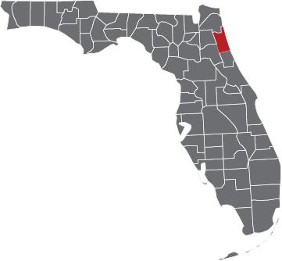
SERVICES THAT CHANGE LIVES
ST. JOHNS COUNTY SHERIFF’S OFFICE (SJSO)
Expanded in-jail services to address substance use
and mental health.
Established a partnership with the local health department to distribute naloxone.
Leveraged community partnerships for re-entry services.
Employs people with lived experience.
IN 4+ YEARS:
Reduced recidivism by 10%.
Notes:
At the St. Johns County Jail in Florida, Sheriff Hardwick took office with a goal of improving re-entry outcomes. This led him and his team to implement a variety of internal and external partnerships and programs.
Health programs at the jail previously only provided medical are. The St. Johns County Sheriff's Office (SJSO) implemented services that address substance use and mental health issues in the jail.
SJSO also began a partnership with the local public health department (which is located on the same campus, in close proximity to the jail) to distribute naloxone to people upon re-entry.
SJSO leveraged the spectacular partnerships they have with community organizations to support:
Job placement programs,
Transportation programs, and
ID programs.
SJSO makes a concerted effort to employ people at their jail who have lived experience with opioid use.
All of these pieces helped contribute to a 10% reduction in recidivism in the 4+ years since this new approach was started.
Source: Provided by St. Johns County Sheriff’s Office

Slide 27

[ Video will be embedded here ]

Slide 28
FOR MORE INFORMATION
Visit the National Sheriffs’ Association website at:
www.sheriffs.org/Overdose-Prevention-Reentry

Slide 29
Thank You

