Slide 1
How to use these slides
These slides are a product of the DVERT Center, a national center of excellence that translates cutting-edge research into actionable guidance for those at the front lines of preventing targeted violence and violent extremism.
These slides contain both presentation materials (the slides themselves) and information for the speaker (in the notes).
Anyone may use these materials for training and educational purposes under the following conditions:
  No alteration: Do not modify, edit, adapt, or otherwise change the content of these slides.
  Attribution: Do not remove or obscure the DVERT Center name or logo (or any other identifying marks).
  No public posting: Do not post, upload, or share these slides on public forums (websites, social media, etc.).
If you have questions, notice an error, or have feedback, please contact us at dvert@cna.org.
The DVERT Center is supported by the National Institute of Justice, Office of Justice Programs, US Department of Justice under Award No. 15PNIJ-24-GK-00750-DOMR. The opinions, findings, and conclusions or recommendations expressed in this document are those of the authors and do not necessarily reflect those of the Department of Justice.

Slide 2
Mental health exploitation
Sextortion networks, including 764, search for vulnerable young people to exploit in online communities, such as those that encourage eating disorders and self-harm.
Notes:
Member of sextortion networks such as 764 look on the internet for young people susceptible to influence and peer pressure. They especially target online communities that encourage eating disorders and self-harm. For example, they might contact young people who post in pro-anorexia or pro-cutting forums.
Young people who struggle with eating disorders, experience suicidal ideation, and engage in self-harm tend to be experiencing social isolation, emotional distress, and low self-esteem. Extremists who contact them take advantage of these vulnerabilities by first offering sympathy and reassurance before grooming their victim and pressuring them to engage in harmful behaviors.
For example: In 2025, a 14-year-old British teen visited a chat room where members were discussing self-harm. A member of the sextortion network messaged her and began grooming her. The perpetrator eventually learned her real name and forced her to engage in sexual acts and self-harm under threat of blackmail.
Extremists also target vulnerable youth in positive online support communities that encourage treatment and recovery. For example, a 13-year-old boy experiencing isolation and depression posted to a mental health–related Discord server seeking friends. He ended up in a live chat where participants encouraged him to kill himself with increasing intensity and pressure until he died by suicide less than a month after first contact.

Slide 3
False stereotypes about radicalization
Extremists may also target teens with:
There is a false stereotype that young people with these conditions are easier to radicalize or convince to engage in terrorism.
Notes:
More broadly, extremists may target teens with mental health diagnoses, neurodivergence, and a history of traumatic experiences.
There is a false stereotype that young people with these conditions are more willing or more easily pressured to commit violent acts.
Extremists are often explicit about this targeted recruitment. They use the term “weaponized autism” to glorify and demean people with autism, whom they perceive as programmable robots ripe for manipulation.
They are often skilled at identify people who are vulnerable because of traumatic or adverse experiences and offering them “empowerment through violence.” The perpetrator may be the only one offering the victim support.

Slide 4


What caregivers and practitioners should watch for
Online indicators
Participation in online communities that encourage or support harmful behaviors
Changes to online activity, including increased time spent online
Migration to fringe or unmoderated spaces
Anonymous gifts (e.g., money, in-game currency)
Online use of suspicious slang or acronyms, including:
  LMIRL/MIRL (“let’s meet in real life”)
  S2R (“send to receive”), WTTP (“want to trade pictures?”), GNOC (“get naked on cam”), and NP4NP (“naked pic for naked pic”)
  POS (“parent over shoulder”), PIR (“parent in room”), and P911 (“parent alert”)
Offline indicators
Sudden or significant changes in behavior, appearance, and sleeping or eating habits
Development of new radical beliefs or extreme habits
Isolation or withdrawal from activities or social and family relationships
Fresh cuts, scratches, bruises, burns, or wounds, often appearing in patterns or forming words or symbols
Writings or drawings in blood or what appears to be blood
Sudden or increasing severity of mental health concerns, including eating disorder behaviors, suicidal ideation, or threats of self-harm
Notes:
Caregivers and practitioners should be aware of potential warning signs for involvement in exploitative mental health–related online communities.
Exhibiting one or more of these behavioral indicators is cause for concern, but it does not necessarily mean that a person is involved in these spaces or is planning an act of violence. It does suggest a need for supportive intervention to address potential underlying vulnerabilities.

Slide 5

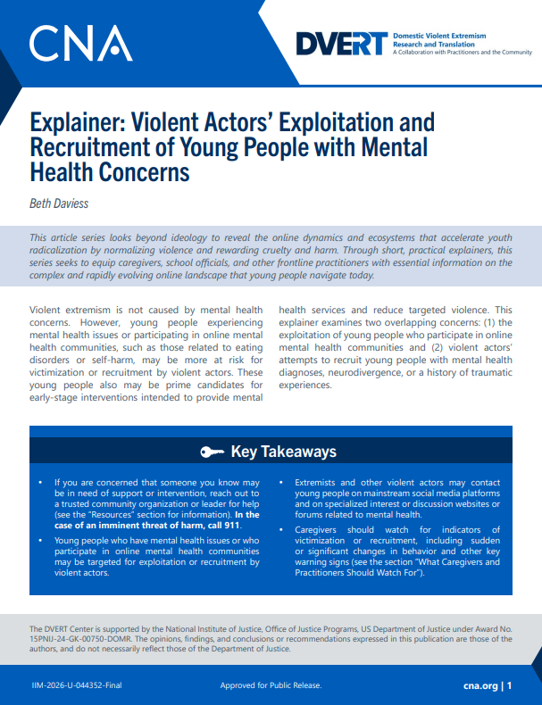
DVERT Resources
Explainer: Violent Actors’ Exploitation and Recruitment of Young People with Mental Health Concerns
  Beth Daviess
Explainer: True Crime Community
  Lauren K. Hagy
Explainer: Gore Content and Violent Extremism
  Rachel Jones and Beth Daviess
Listen to our podcast – The DVERT Brief

