Slide 1
How to use these slides
These slides are a product of the DVERT Center, a national center of excellence that translates cutting-edge research into actionable guidance for those at the front lines of preventing targeted violence and violent extremism.
These slides contain both presentation materials (the slides themselves) and information for the speaker (in the notes).
Anyone may use these materials for training and educational purposes under the following conditions:
  No alteration: Do not modify, edit, adapt, or otherwise change the content of these slides.
  Attribution: Do not remove or obscure the DVERT Center name or logo (or any other identifying marks).
  No public posting: Do not post, upload, or share these slides on public forums (websites, social media, etc.).
If you have questions, notice an error, or have feedback, please contact us at dvert@cna.org.
The DVERT Center is supported by the National Institute of Justice, Office of Justice Programs, US Department of Justice under Award No. 15PNIJ-24-GK-00750-DOMR. The opinions, findings, and conclusions or recommendations expressed in this document are those of the authors and do not necessarily reflect those of the Department of Justice.

Slide 2
True Crime Community (TCC)
Internet subculture characterized by fascination with high-profile mass killers, especially mass shooters and school shooters
Linked to at least 7 school shootings and 9 attempted school shootings between 2024-2025
Key features:
Interest in high-profile killers
Insider cultural references
Fandom activities
Notes:
The True Crime Community, or TCC, is an internet subculture characterized by fascination with high-profile mass killers, especially mass shooters and school shooters.
Its participants have played a large role in recent incidents of targeted violence: from 2024 to 2025, the TCC was linked to at least seven school shootings and nine attempted shootings in the United States (plus at least 6 international attacks and plots).
It is not a formal group. Its participants share three key features:
Interest in high profile killers (especially the perpetrators of the 1999 Columbine High School shooting), often blurring the line between mere interest and glorification
Cultural references to things past school shooters liked (e.g., wearing a KMFDM band t-shirt like one of the Columbine perpetrators)
Fandom activities: creating digital art featuring mass shooters, referencing past shooters’ names in notebooks or usernames, making friendship bracelets with mass shooters’ names, putting up posters or photos of mass shooters in their bedroom, and developing one-sided attachments to shooters

Slide 3




Where do people encounter TCC content?
Mainstream Platforms
Unmoderated Private Spaces
Private Discord Servers
Telegram
Discord
Instagram
Snapchat
X (Twitter)
Gore websites
Kik
Minecraft
YouTube
Roblox
TikTok
Notes:
TCC content is found primarily on mainstream social media platforms including Discord, Minecraft, Reddit, Roblox, TikTok, Tumblr, and X. Often, this content is found within mental health or eating disorder interest communities on these platforms.
TCC users invite new users into private chats or forums on private Discord servers, Telegram, or even gore forums dedicated to sharing videos and images of extreme violence. In these unmoderated or encrypted (private) spaces, individuals typically encounter increasingly violent content.

Slide 4

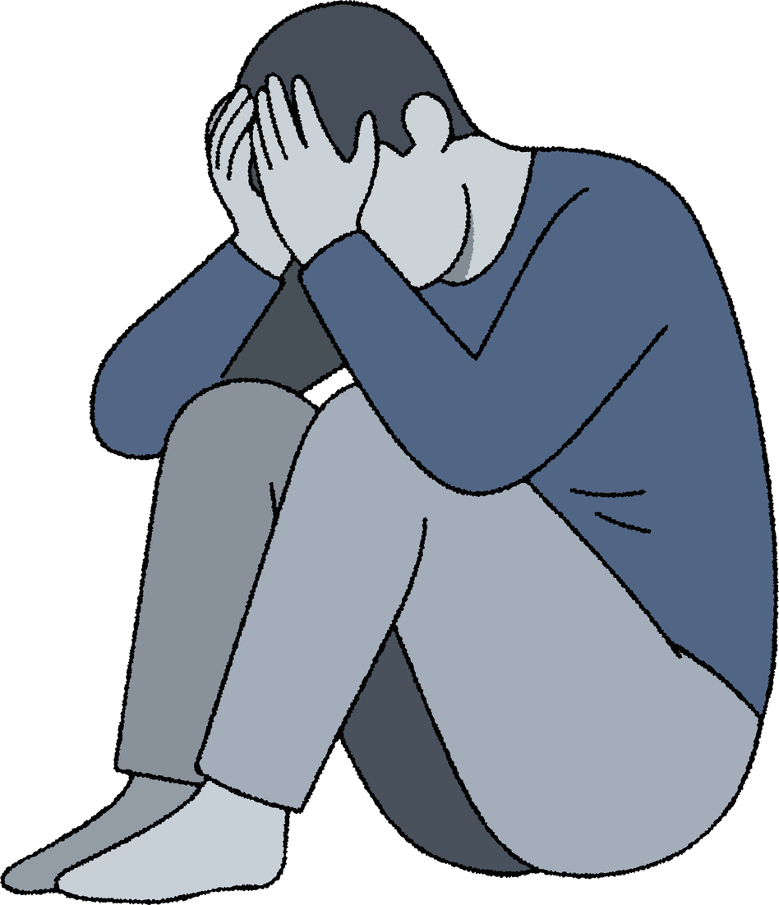

What drives individuals to the TCC?
Emotional appeal
Vulnerable youth with unmet needs
Sense of community and belonging
PULL
PUSH
Aesthetic appeal
  Social isolation
  Bullying and harassment
  Mental health challenges
Feeling of being edgy or cool
PULL
Notes:
The most extreme and violent subsets of the TCC often attract young people with unmet social or emotional needs, especially those experiencing the following:
Social isolation
Bullying
Mental health challenges
These vulnerable young people may encounter TCC content on mainstream social media platforms, including Discord, Minecraft, Reddit, Roblox, TikTok, Tumblr, and X.
The TCC appeals to these youth in two ways:
Emotional appeal. A sense of connectedness to a community. When other TCC users like their posts or send them invitations to private chats or forums, isolated young people may feel a sense of belonging and validation. The TCC then becomes an outlet for them to express sadness and suicidality and to potentially explore their violent fantasies.
Aesthetic appeal. Participating in the TCC gives teenagers an opportunity to challenge social norms by engaging with deviant or taboo individuals or content. This content is often deceptively “cute.” Aesthetic elements such as soft pink or cute stickers might cover violent elements including blood and self-harm wounds. Replicating this aesthetic can be a warning sign of participation in the TCC.

Slide 5


What caregivers and practitioners should watch for
Online indicators
Repeatedly researching or discussing past shootings or shooters
Directing humor or praise at mass casualty events
Sharing or saving photos or videos of past shootings or shooters
Spending an excessive amount of time online (especially in isolation)
Participating in fringe, unmoderated, or invite-only spaces
Offline indicators
Sudden or significant changes in behavior, including self-harm or suicidality
Mood changes
Expressions of hopelessness, low self-esteem, or hatred of humanity
Deteriorating mental health
Fascination with violence
Notes:
Caregivers and practitioners should be aware of potential warning signs for involvement in the TCC.
Exhibiting one or more of these behavioral indicators is cause for concern, but it does not necessarily mean that a person is involved in the TCC or is planning an act of violence. It does suggest a need for supportive intervention to address potential underlying vulnerabilities.

Slide 6

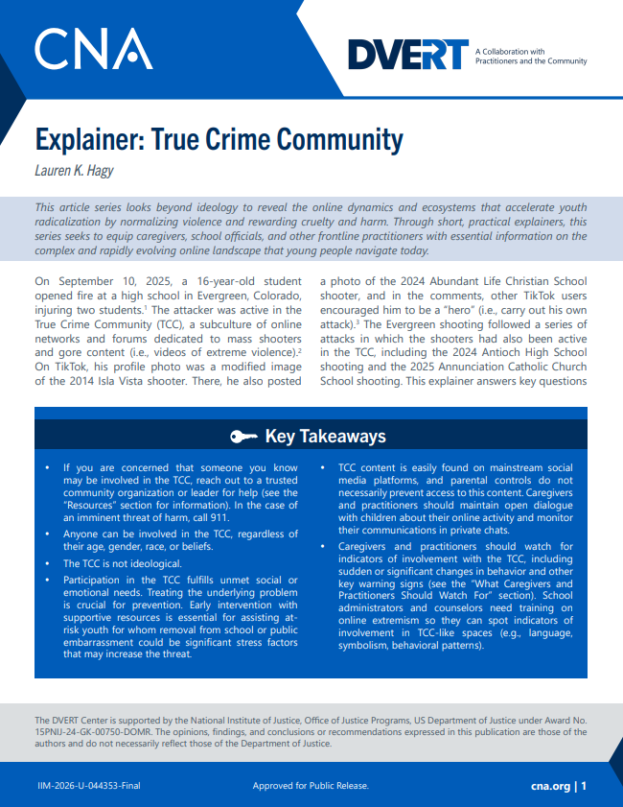
DVERT Resources
Explainer: True Crime Community
  Lauren K. Hagy
Explainer: Gore Content and Violent Extremism
  Rachel Jones and Beth Daviess
764 and The Com: Misconceptions and Guidance
  Beth Daviess
Listen to our podcast – The DVERT Brief

